Slide 1




Iris Day
In C4.5 Algorithm

Slide 2
Definition!
The C4.5 algorithm is used in Data Mining as a Decision Tree Classifier which can be employed to generate a decision, based on a certain sample of data

Slide 3
Introduction
The algorithm used to build a C4.5 tree decision .
Using two data :
1- iris_data:
2- iris_names

Slide 4
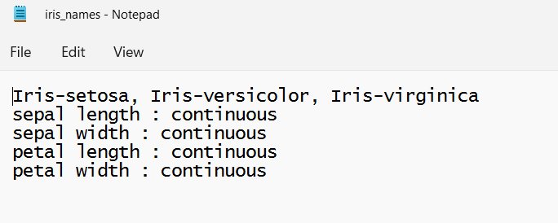
Iris_names.txt

Slide 5
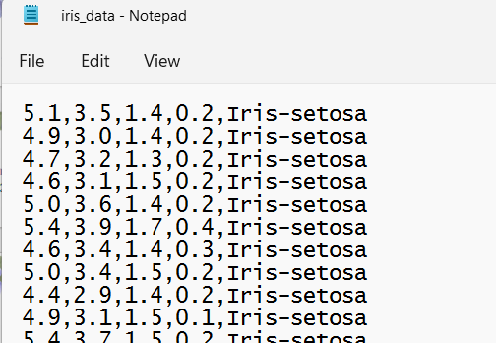
Iris_data.txt

Slide 6
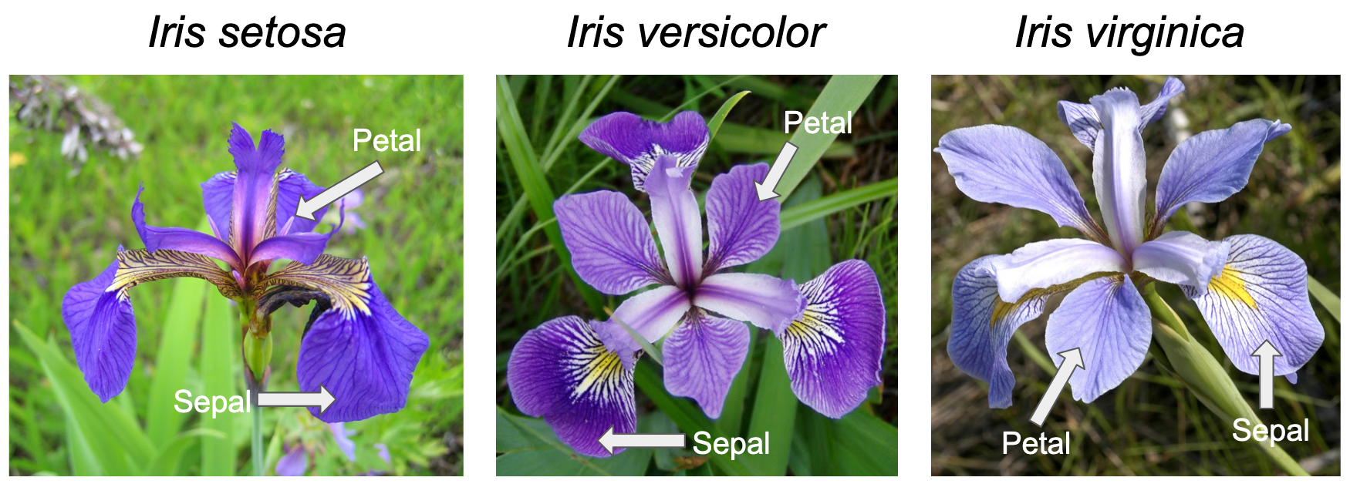
The 3 class labels

Slide 7
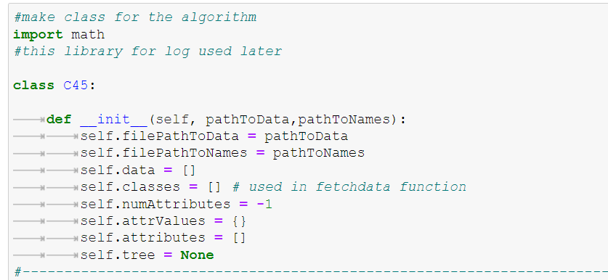
Class C4.5

Slide 8
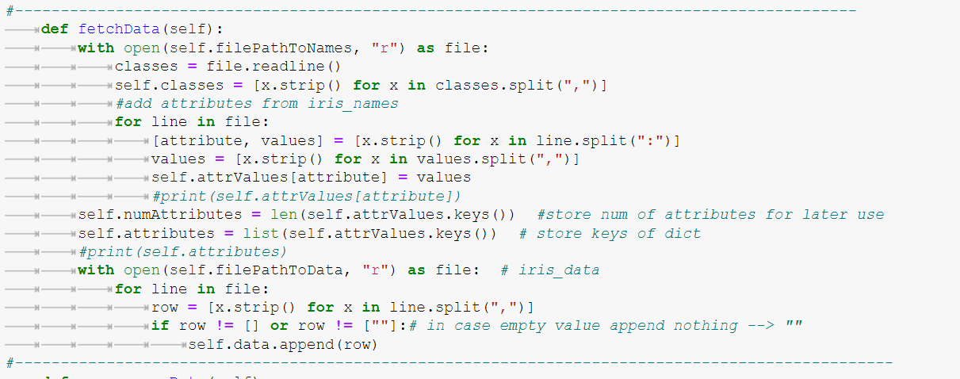
fetchData function

Slide 9
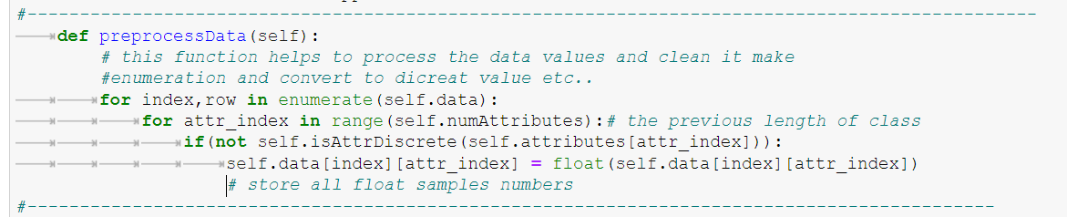
preprocessData function

Slide 10
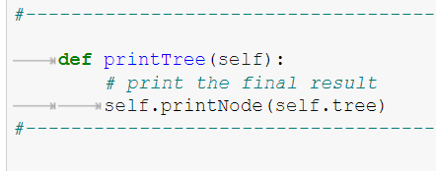
printTree function

Slide 11
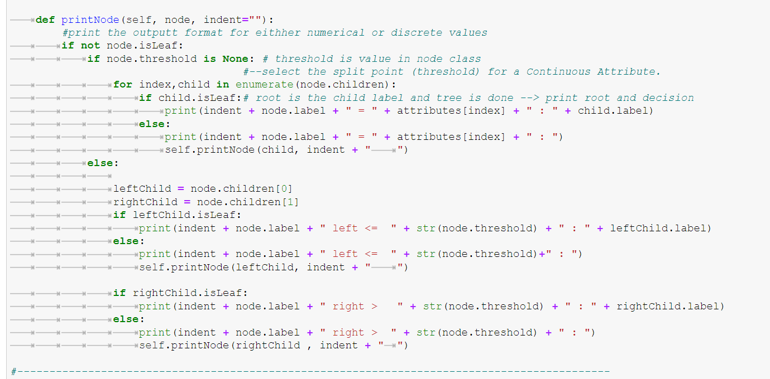
printNode function

Slide 12
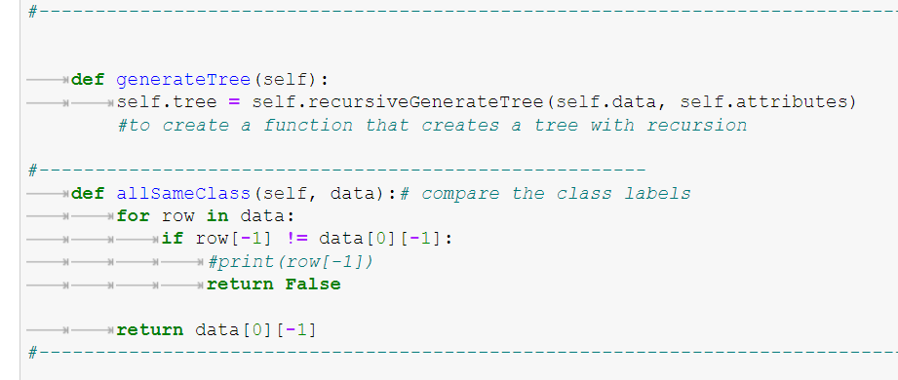
generateTree allSameClass function s

Slide 13
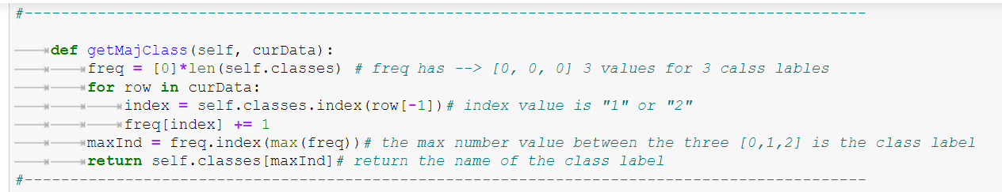
getMajClass function

Slide 14
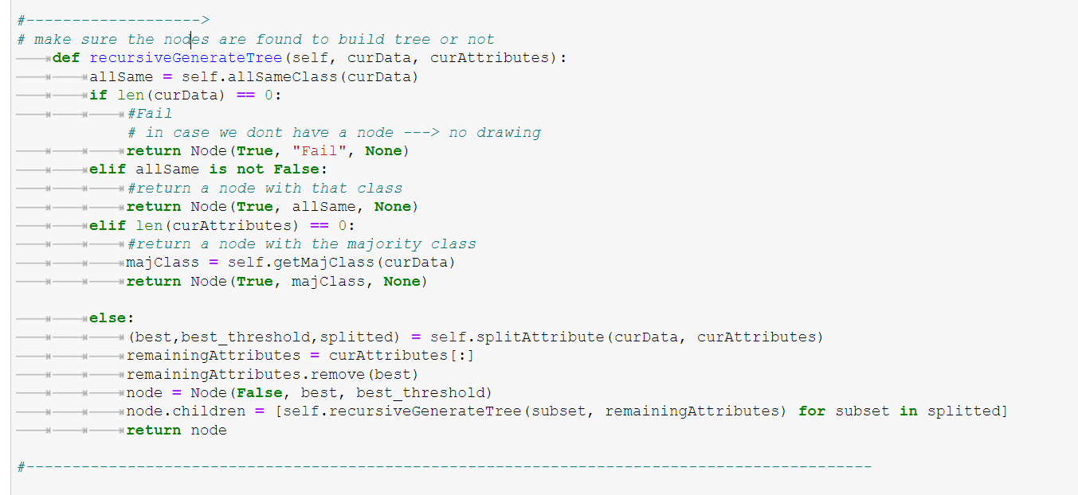
recursiveGenerateTree function

Slide 15
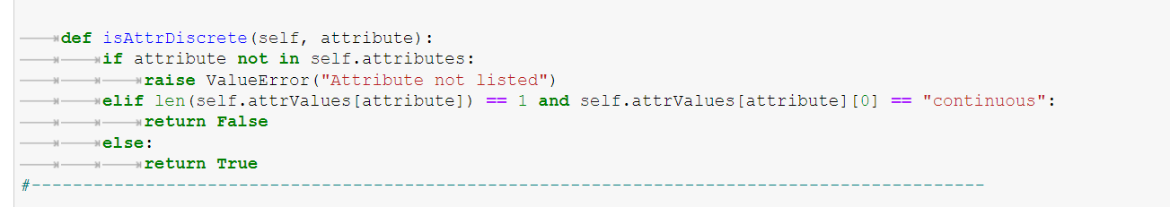
isAttrDiscrete function

Slide 16
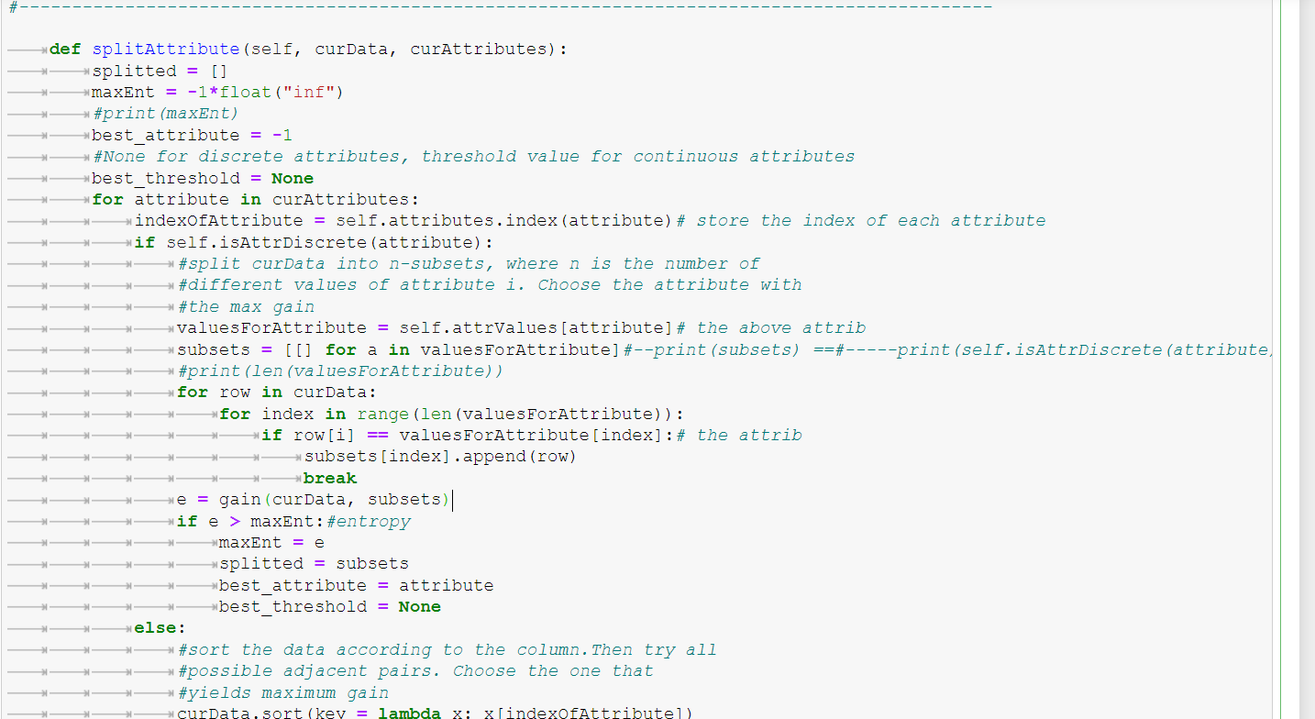
splitAttribute function

Slide 17
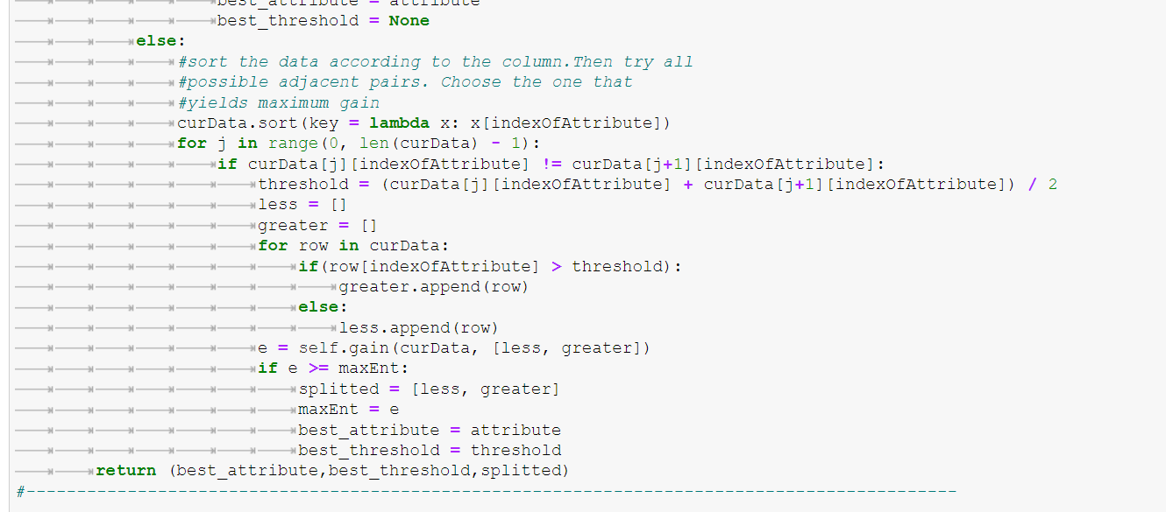

Slide 18
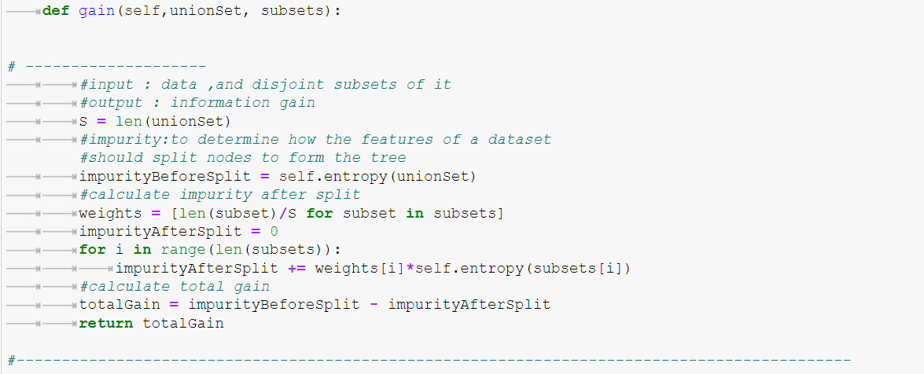
Gain function

Slide 19
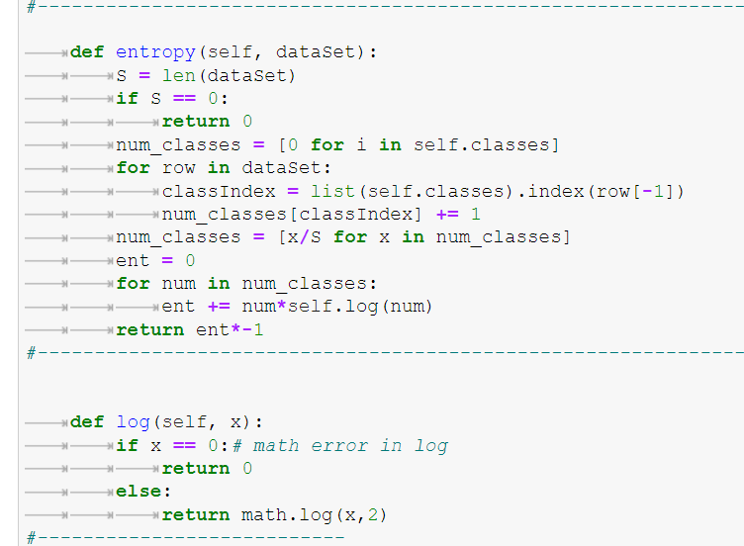
Entropy & log functions

Slide 20
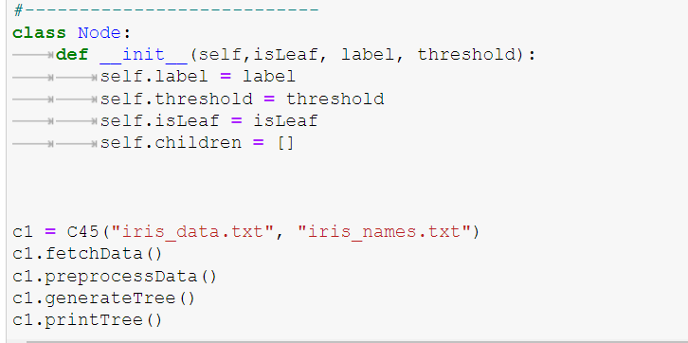
Start the algorithm :

Slide 21
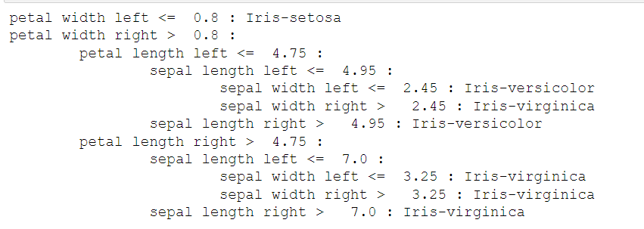
The output tree:

Slide 22
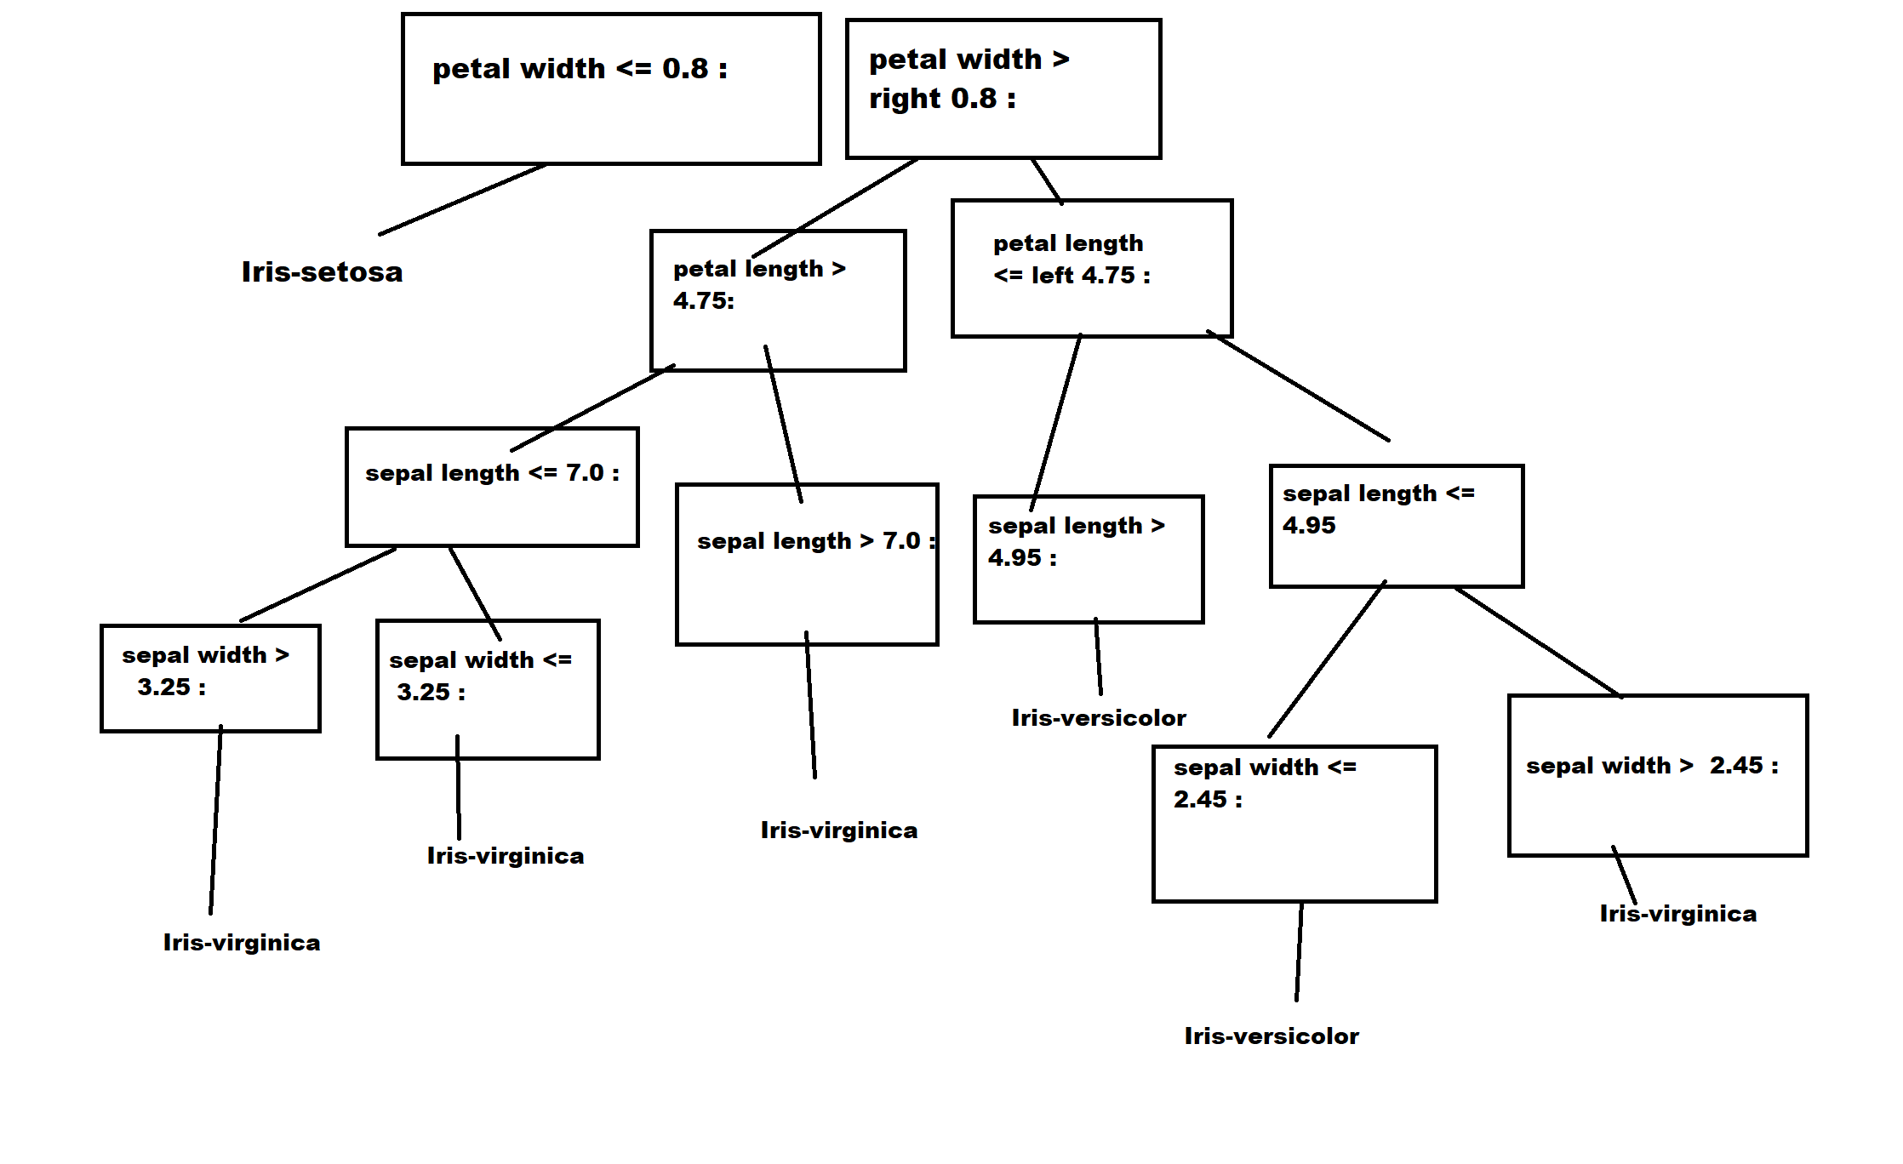
The output tree:

Slide 23
Train data from cancer data

Slide 24
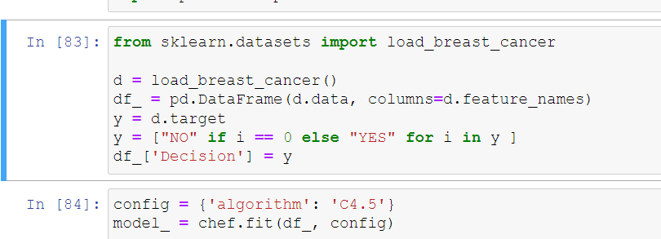

Slide 25
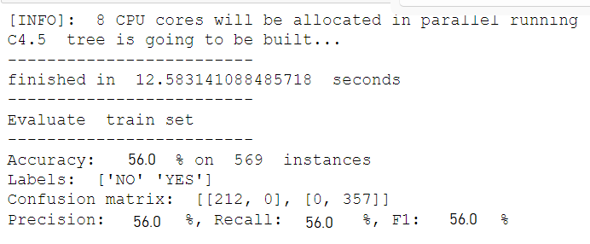
The output :

Slide 26

Team member : - Rana hamed - Sec:2 -Group: 2

